Slide 1
Deliverable 3
Adam Afilaka: Developer/Programmer
Ashley Braun: Business Analyst/Project Manager
Zaid Islam: Cyber Security Engineer
Rithika Sayini: Researcher/Programmer
Shanese Scott: Database Administrator
Xin Zheng: Quality Assurance

Slide 2
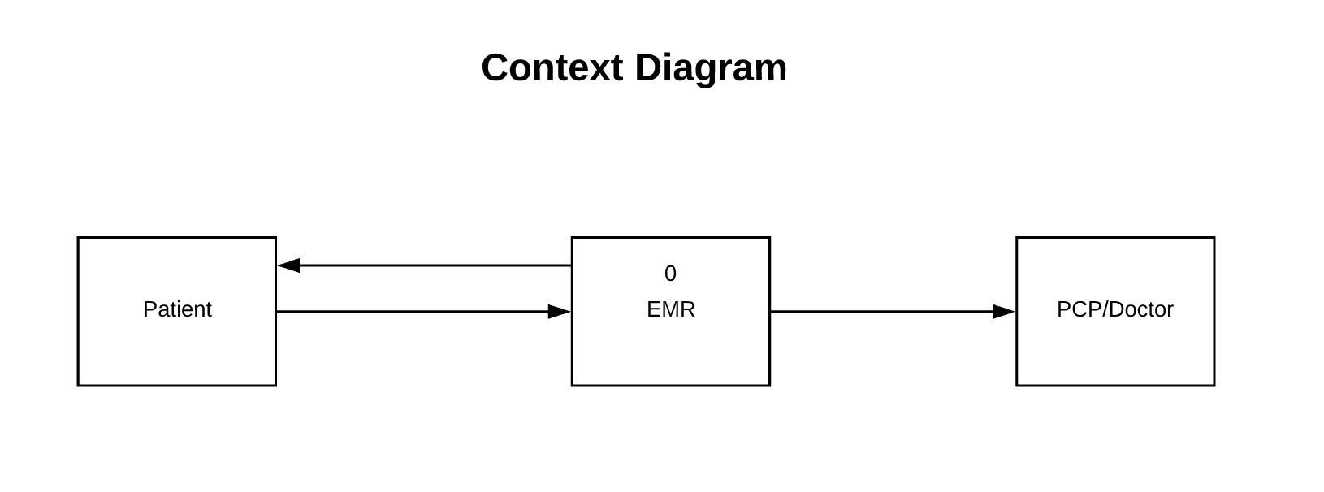
Context Diagram

Slide 3
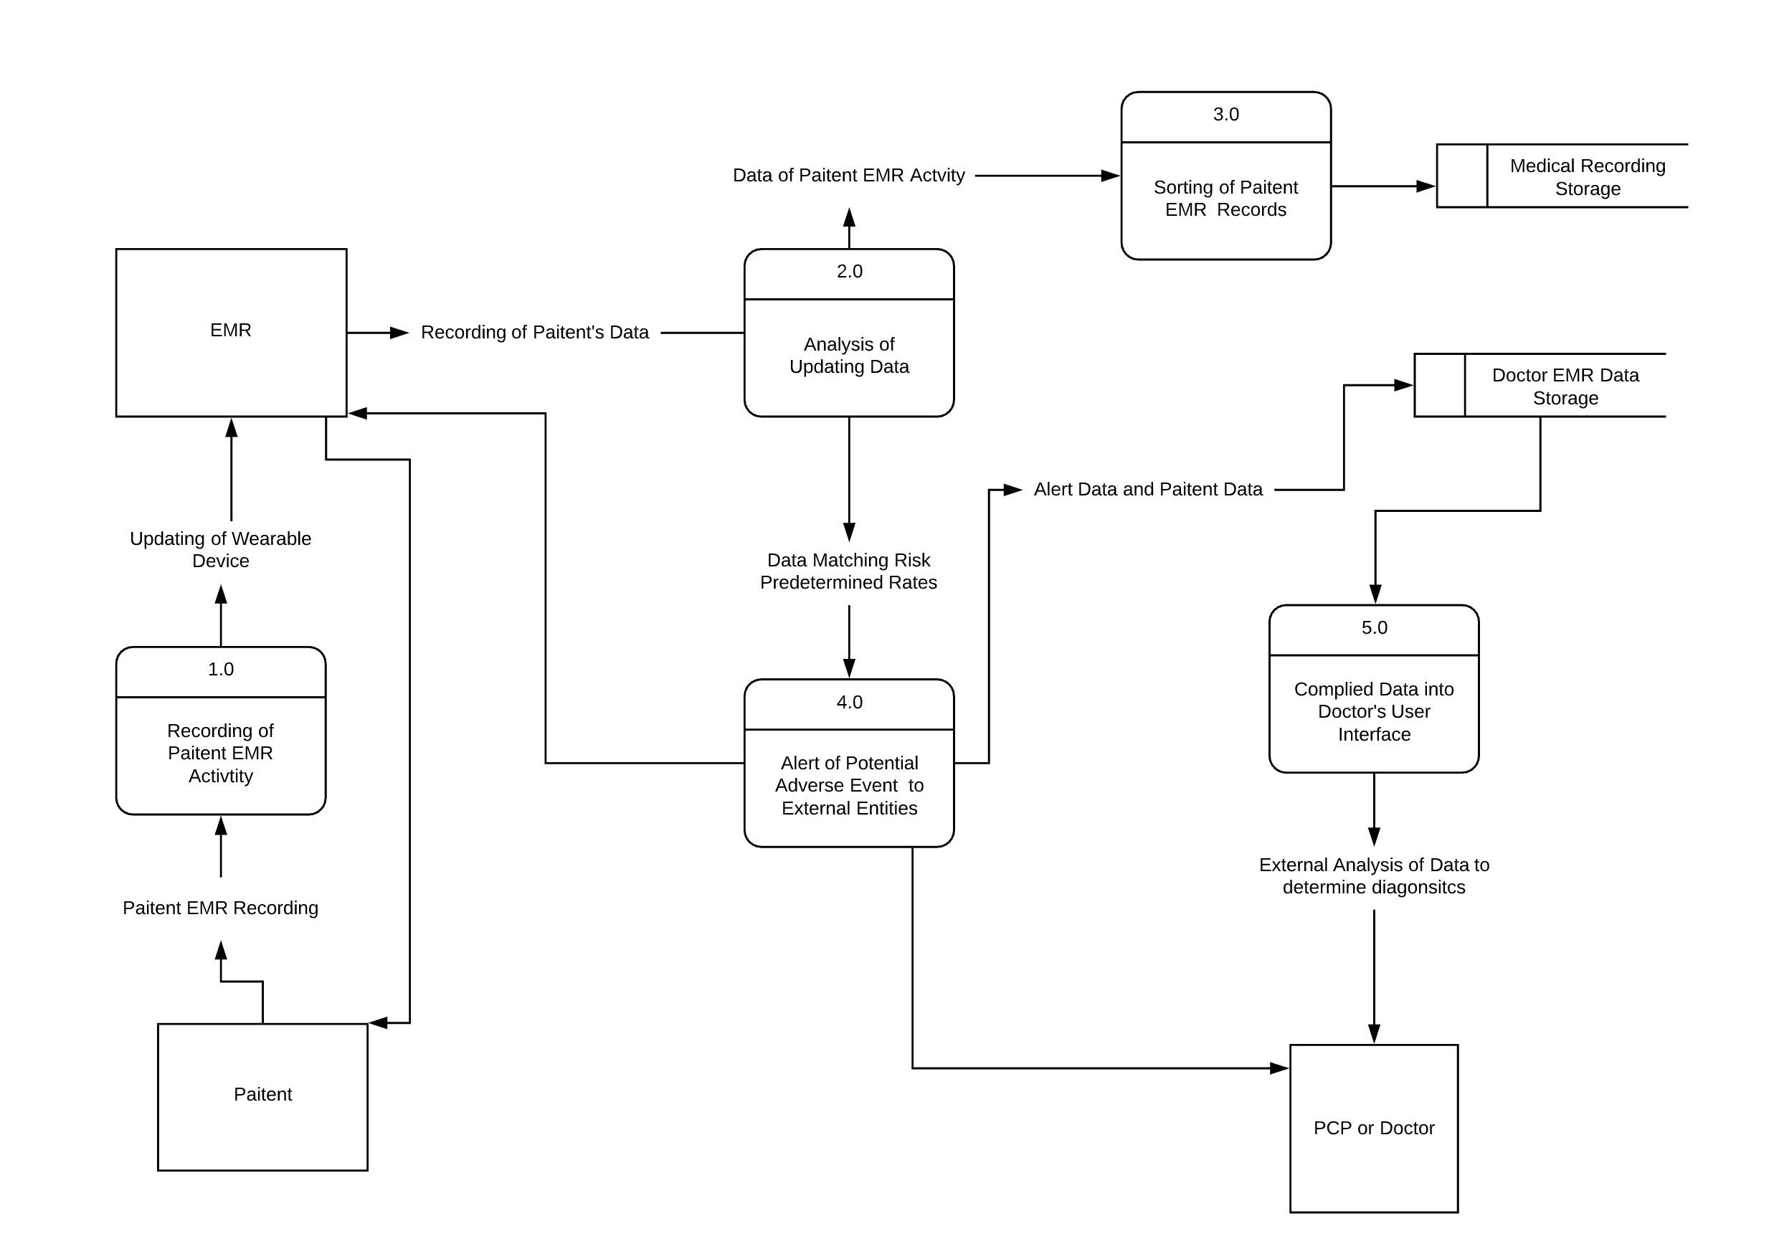
Level 0
External Entities
Patient:
EMR:
Doctor:
Processes:
1.0: Recording of Data Activity:
2.0: Analysis of Updating Data:.
3.0: Sorting of Patient EMR Records:
4.0: Alert of Potential Adverse Event:
5.0: Compiled Data into User Interface:
Data Storages
Medical Recording Storage:.
Doctor EMR Data Storage:

Slide 4
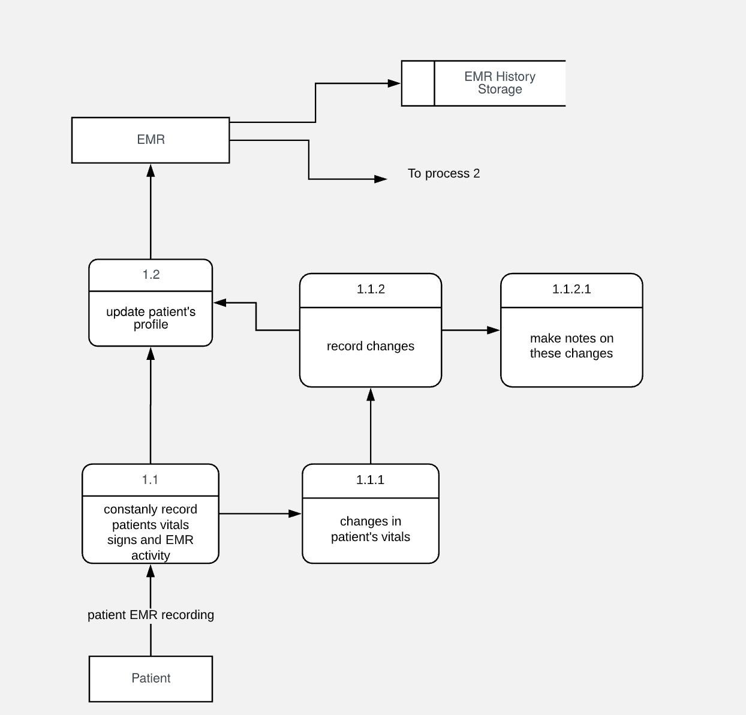
Process 1- Recording of Patient EMR Activity
External Entities: Patient, EMR
Levels:
Level 1: 1.1, 1.2
Level 2: 1.1.1, 1.1.2,
Level 3: 1.1.2.1
Storage: EMR database storage

Slide 5
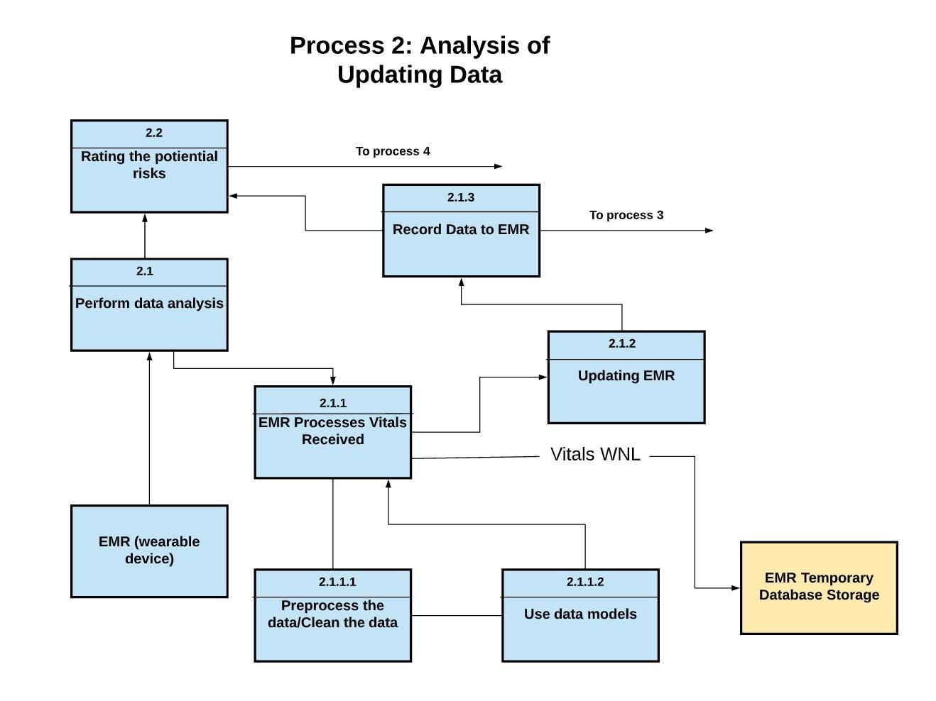
Process 2-Analysis of Updating Data
External Entities: EMR
Levels
Level 1: 2.1, 2.2
Level 2: 2.1.1, 2.1.2, 2.1.3
Level 3: 2.1.1.1, 2.1.1.2
Storage: EMR database storage

Slide 6
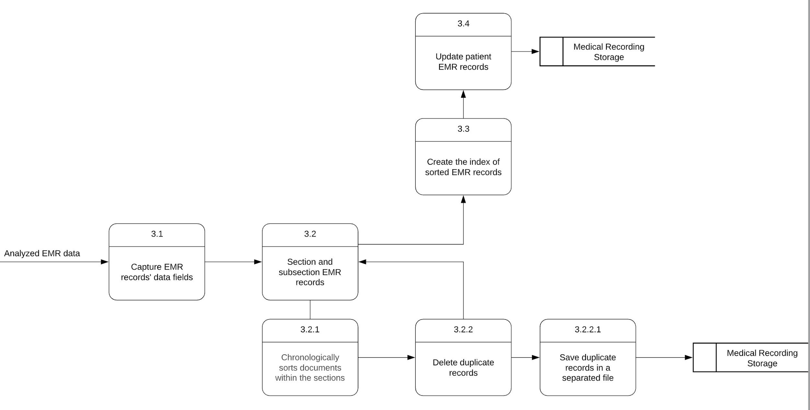
Process 3- Sorting of Patient EMR Records
External Entities: None
Levels
Level 1: 3.1,3.2, 3.3, 3.4
Level 2: 3.2.1,3.2.2
Level 3: 3.2.2.1
Data Storages:
Medical Recording Storage

Slide 7
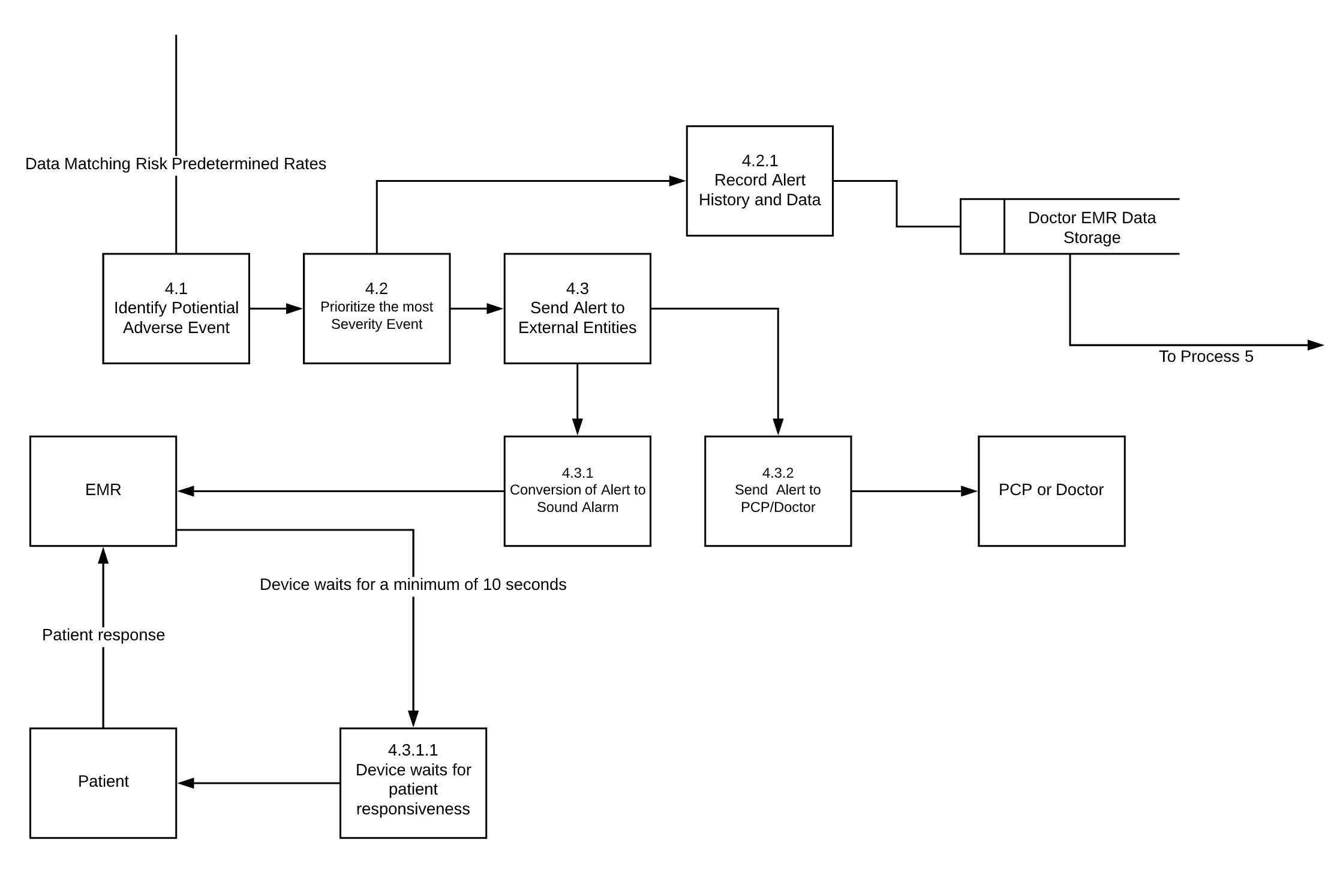
Process 4-Alert of Potential Adverse Event to External Entities
External Entities:
EMR, PCP/Doctor, Patient
Levels:
Level 1: 4.1, 4.2, 4.3, 4.4
Level 2: 4.2.1, 4.3.1, 4.3.2
Level 3: 4.3.1.1
Data Storages:EMR History Storage

Slide 8
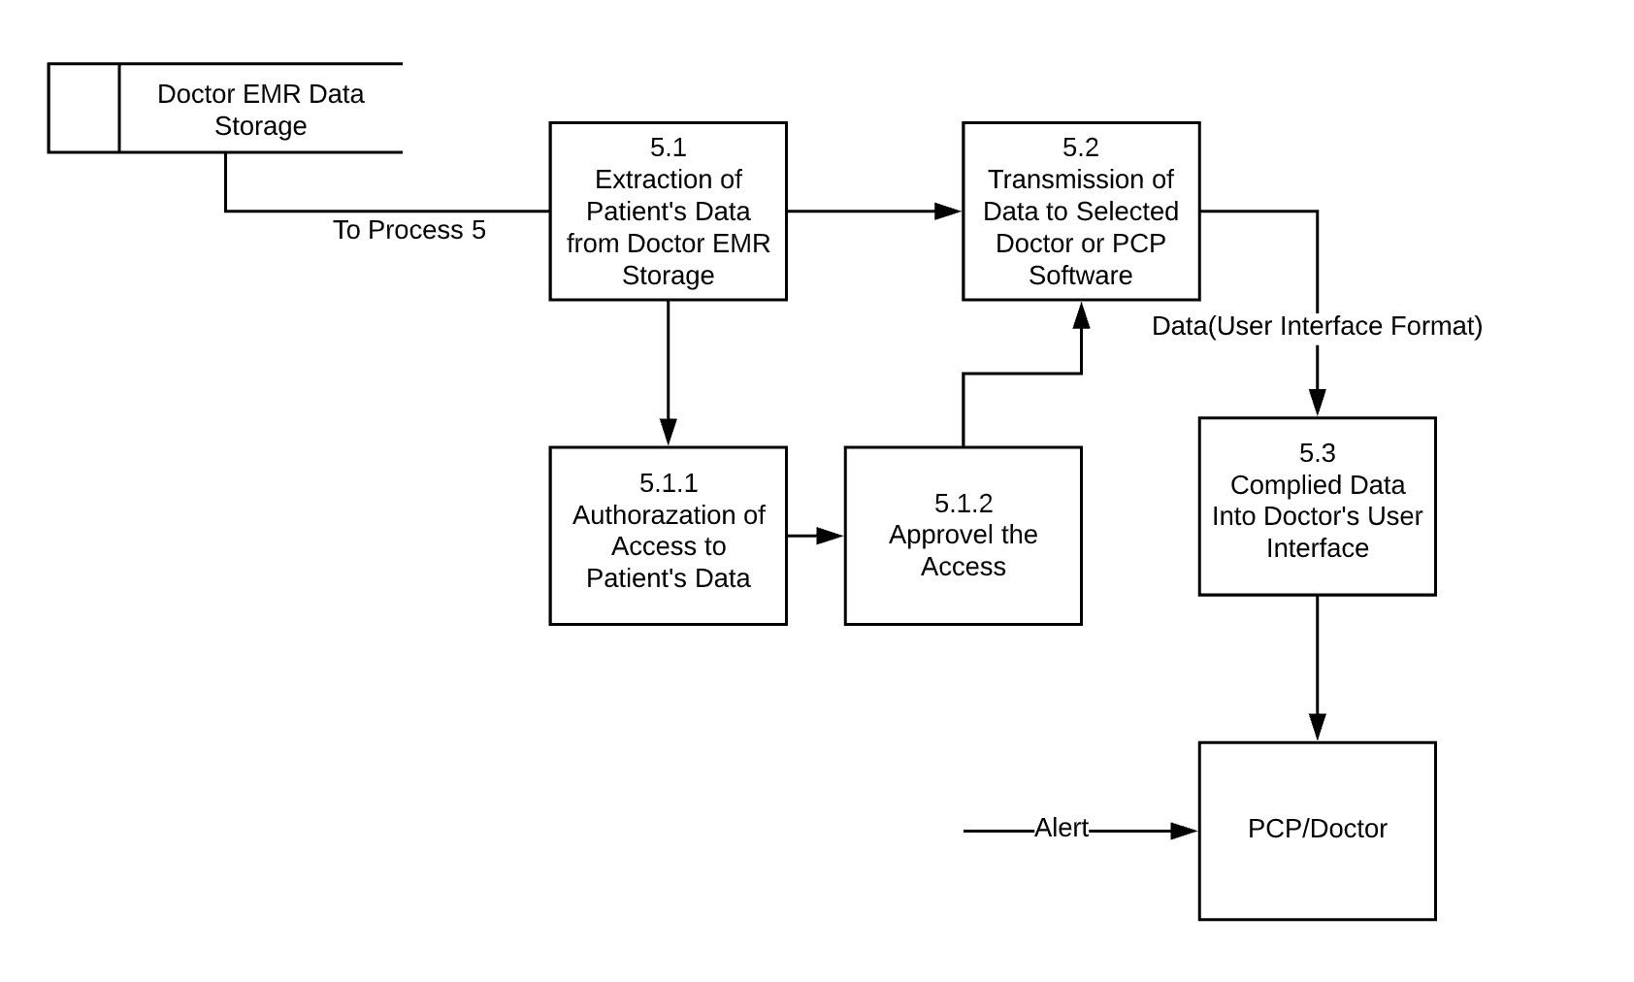
Process 5- Compiled Data into Doctor’s User Interface
External Entities:
PCP/Doctor
Levels:
Level 1: 5.1, 5.2, 5.3
Level 2: 5.1.1, 5.1.2
Data Storages:
Doctor EMR Data Storage

Slide 9
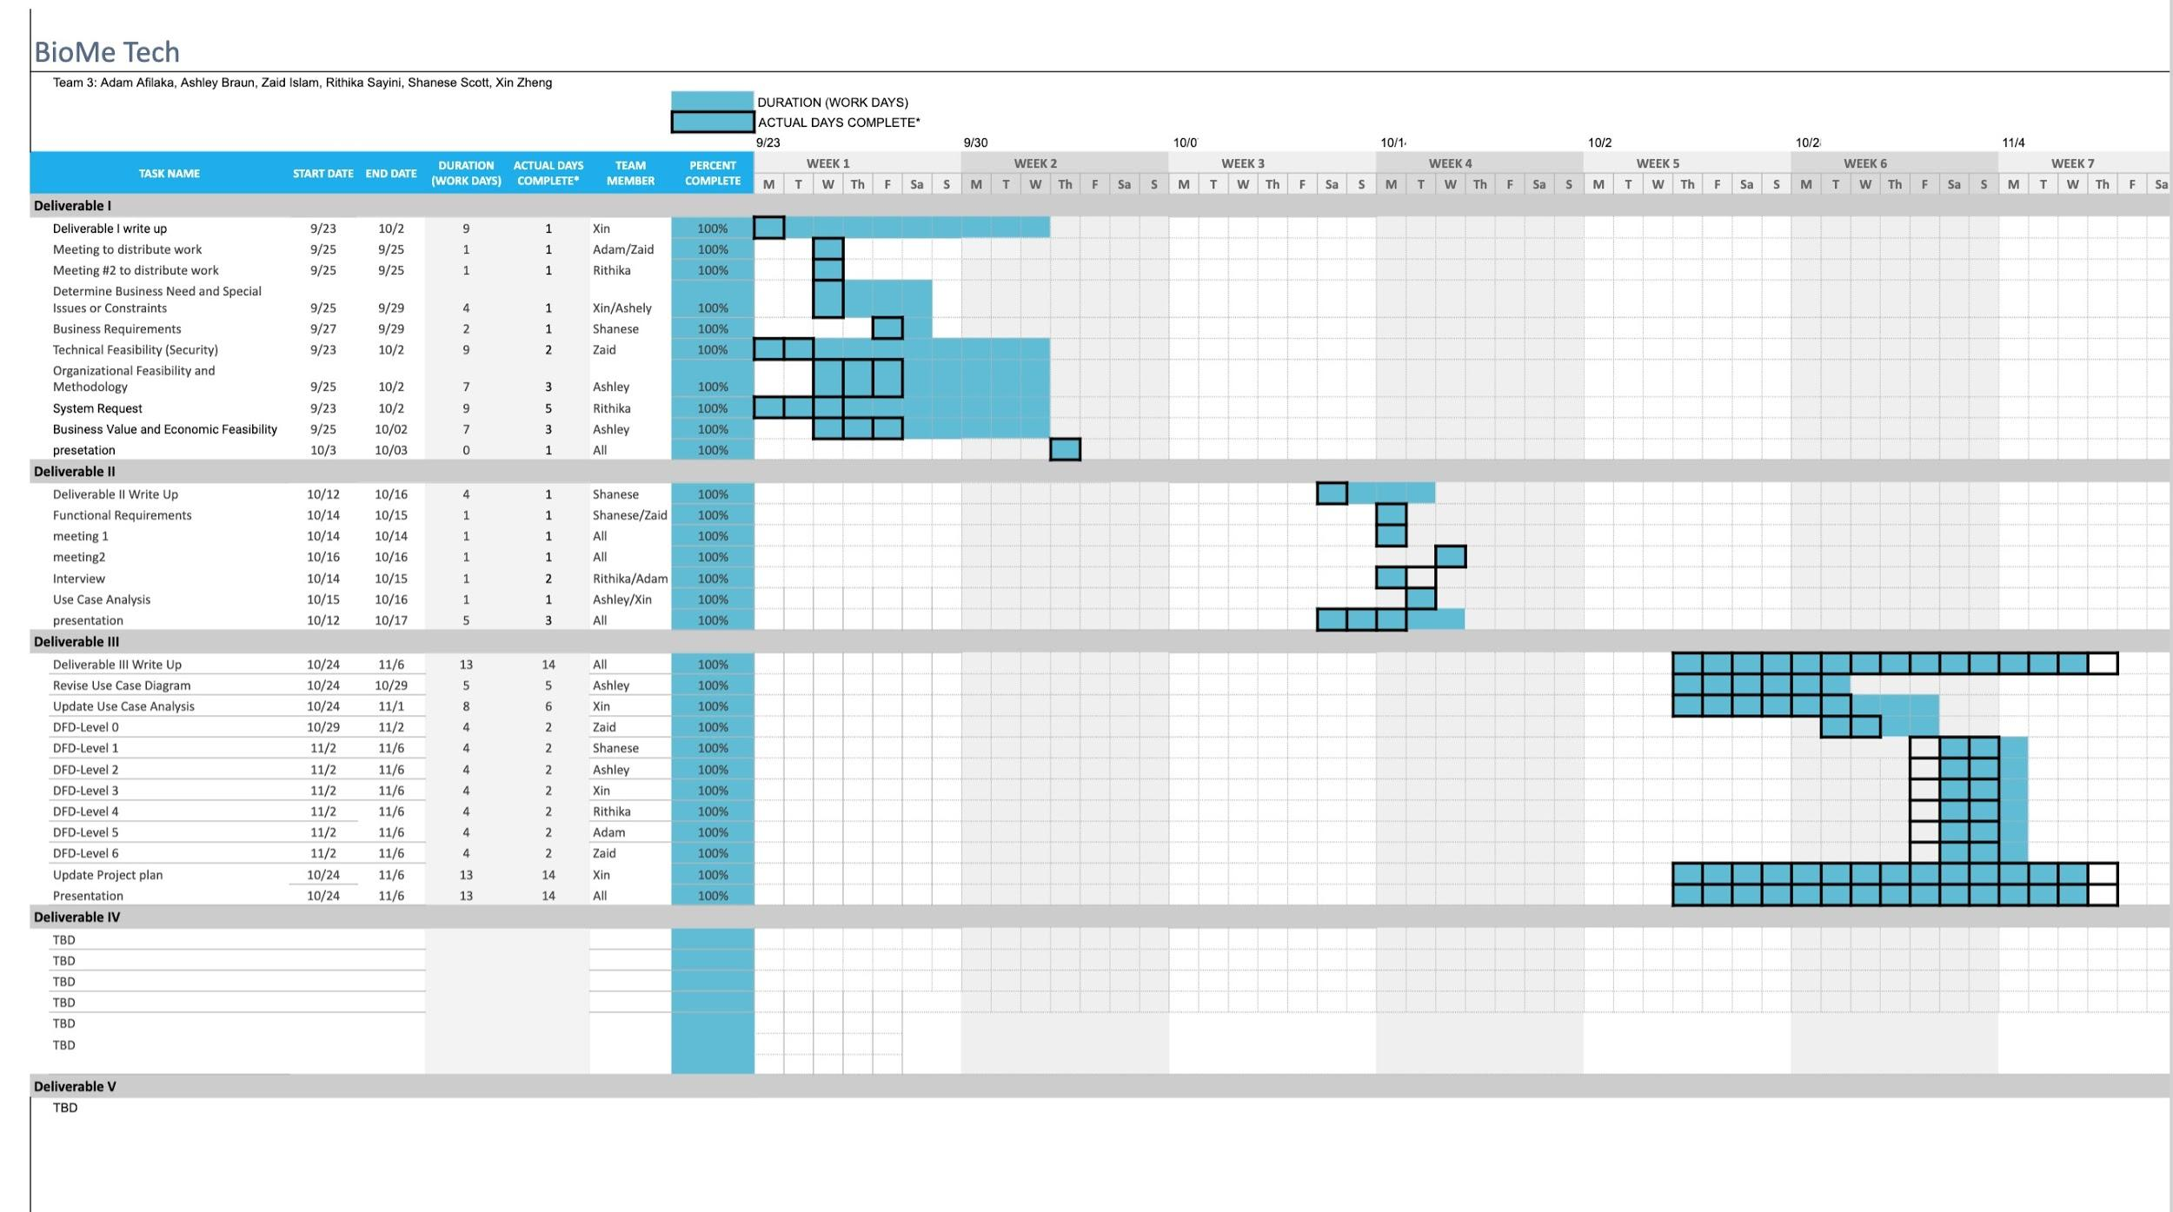
Project Plan

Slide 10
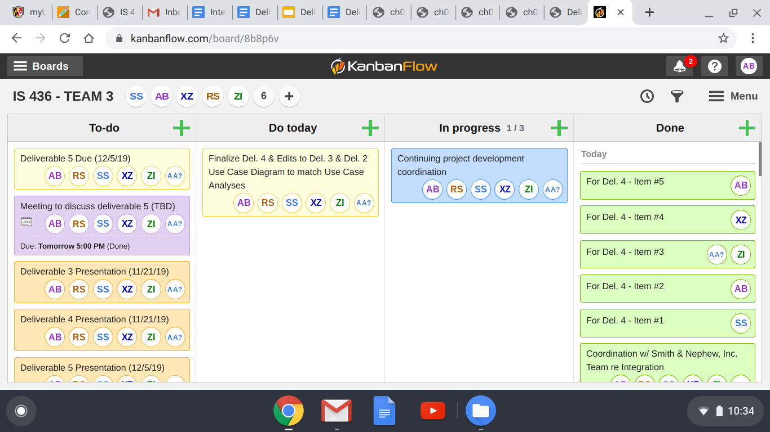
Kanban Board

